Slide 1
Presentation Credit Card Fraud Detection
By Indrajeet Chaudhary, Raviraj Kangle ,Amarjeet
DCS 49 OCT-2022 BATCH

Slide 2
Index:
Problem statement
Objective
Key Inside
Approach
Reading and Understanding the Data
EDA
Train/Test Data Splitting
Model Building and Hyper parameter Tuning
Model Selection and Model Building
Cost Benefit Analysis
Attachments

Slide 3
Problem statement:
In recent times, the number of fraud transactions has increased drastically due to which credit card companies are facing a lot of challenges. For many banks, retaining high profitable customers is the most important business goal. Banking fraud, however, poses a significant threat to this goal. In terms of substantial financial loss, trust, and credibility, banking fraud is a concerning issue for both banks and customers alike. With the rise in digital payment channels, the number of fraudulent transactions is also increasing as fraudsters are finding new and different ways to commit such crimes.
Finex is a leading financial service provider based out of Florida, US. It offers a wide range of products and business services to customers through different channels, ranging from in-person banking and ATMs to online banking. Over the last few years, Finex has observed that a significantly large number of unauthorized transactions are being made, due to which the bank has been facing a huge revenue and profitability crisis. Many customers have been complaining about unauthorized transactions being made through their credit/debit cards. It has been reported that fraudsters use stolen/lost cards and hack private systems to access the personal and sensitive data of many cardholders. They also indulge in ATM skimming at various POS terminals such as gas stations, shopping malls, and ATMs that do not send alerts or do not have OTP systems through banks. Such fraudulent activities have been reported to happen during non-peak and odd hours of the day leaving no room for suspicion.

Slide 4
Objective:
Suppose you are part of the analytics team working on a fraud detection model and its cost-benefit analysis. You need to develop a machine learning model to detect fraudulent transactions based on the historical transactional data of customers with a pool of merchants. Based on your understanding of the model, you have to analyse the business impact of these fraudulent transactions and recommend the optimal ways that the bank can adopt to mitigate the fraud risks.

Slide 5
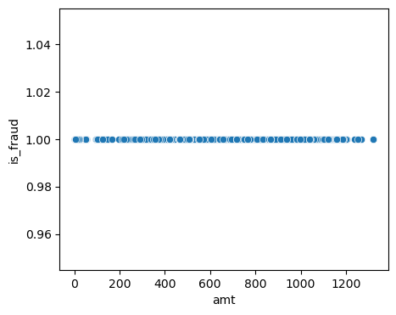
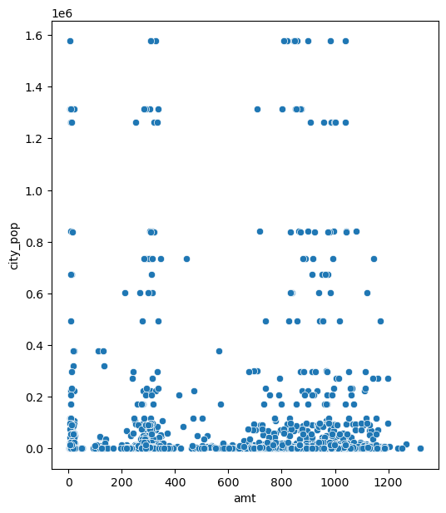
Key Inside
Fraud happens at all cost
No clear relation between city population and the amount of spending.

Slide 6
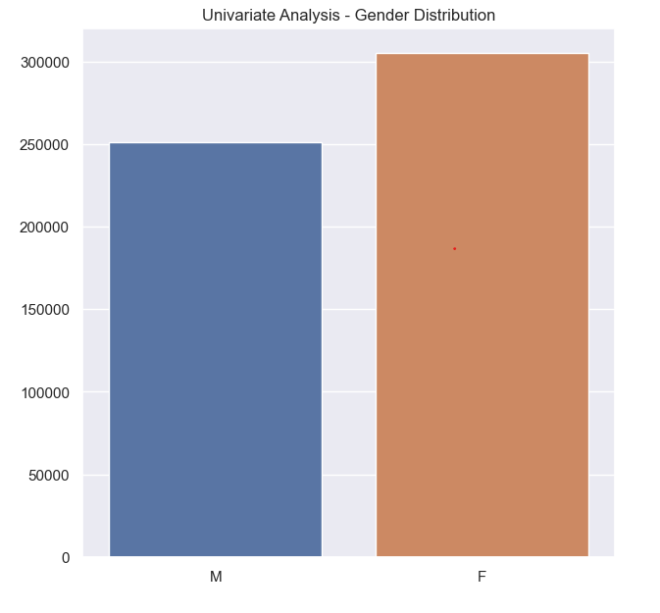
Key Inside
Gender Distribution Plot
Female having more fraudulent transactions than men.
Need to focus on both the gender equally to check fraudulent.

Slide 7
Approach : Reading and Understanding the Data
This is a simulated data set taken from the Kaggle website and contains both legitimate and fraudulent transactions.
The data set contains credit card transactions of around 1,000 cardholders with a pool of 800 merchants from 1 Jan 2019 to 31 Dec 2020. It contains a total of 18,52,394 transactions, out of which 9,651 are fraudulent transactions. The data set is highly imbalanced, with the positive class (frauds) accounting for 0.52% of the total transactions. Now, since the data set is highly imbalanced, it needs to be handled before model building. The feature 'amt' represents the transaction amount. The feature 'is_fraud' represents class labelling and takes the value 1 the transaction is a fraudulent transaction and 0, otherwise.

Slide 8
Exploratory data analytics (EDA)
In this step, We need to perform univariate and bivariate analyses of the data, followed by feature transformations, if necessary. We can also check whether or not there is any skewness in the data and try to mitigate it, as skewed data can cause problems during the model-building phase.
Train/Test Data Splitting:
We need to split the data set into training data and testing data in order to check the performance of your models with unseen data. You can use the stratified k-fold cross-validation method at this stage. For this, we need to choose an appropriate k value such that the minority class is correctly represented in the test folds.

Slide 9
Model Building and Hyper parameter Tuning
The algorithms that will be used in order to create classification models that would be sensitive to detecting fraudulent transactions are:
Logistic Regression
Decision Trees
Random Forest
XGBoost
Each algorithm will have an un sampled model and will then be compared by using sampling methods - SMOTE and ADASYN

Slide 10
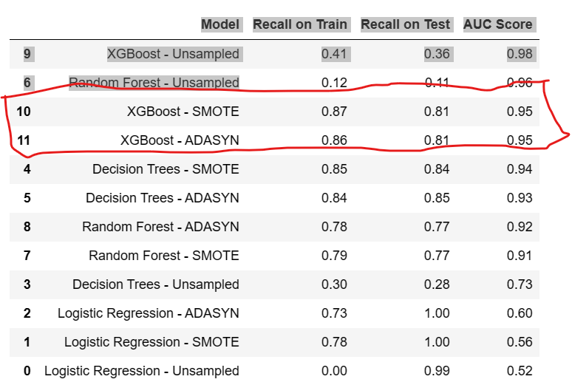
Model Selection and Model Building
Based on the Recall scores, AUC Scores, and Confusion Matrices collected from the 12 algorithms (4 algorithms - unsampled and sampled), following is the summary of all values to help us pick the best model of all:
we can see in above XGBoost-SMOTE & XGBoost-ADASYN model is best model.

Slide 11
Cost Benefit Analysis:
The Cost Benefit Analysis is to be done on the original data
Merging the train and test data to make an original data frame
Let us take a look at what we need to do in order to perform the cost-benefit analysis step by step:
Part I: Analyse the dataset and find the following figures:
Average number of transactions per month = 46309
Average number of fraudulent transactions per month = 178
Average amount per fraudulent transaction = 528
Part II: Compare the cost incurred per month by the bank before and after the model deployment:
Cost incurred per month before the model was deployed = Average amount per fraudulent transaction * Average number of fraudulent transactions per month= 93,984.00
Cost incurred per month after the model is built and deployed: = 38,308.38
Final savings = Cost incurred before - Cost incurred after= 55,675.63

Slide 12
Attached file
Capstone_ Project Credit card fraud detection Final Project DS49BA By_Indrajeet & Raviraj
Cost Benefit Analysis
Structured+Problem+Solving
Video Presentation

Slide 13
Thank You

